Slide 1
Entrepreneurship & The Strategic Management of Place
David Audretsch

Slide 2
Link between Entrepreneurship & Economic Growth
“Our lacunae in the field of entrepreneurship needs to be taken seriously because there is mounting evidence that the key to economic growth and productivity improvements lies in the entrepreneurial capacity of an economy”
EU President, Romano Prodi
Notes:
Why not “Evolving from Physical Capital...“ (Moving / Shifting / …)

Slide 3
What Determines Entrepreneurship Across Geographic Space?
“What is the most striking feature of the geography of economic activity? The short answer is surely concentration…production is remarkably concentrated in space.” --Paul Krugrman
The Geography of Trade (MIT Press, 1991)
Entrepreneurship activity similarly varies substantially across geographic space -- Glaeser, Kerr & Kerr, “Entrepreneurship and Urban Growth: An Empirical Assessment with Historical Mines,” Review of Economics and Statistics, 2015

Slide 4
Determinants of Entrepreneurship Across Geographic Space
Factors & Resources – human capital, social capital, knowledge, labor force composition, growth
Spatial Structure & Organization – clusters, diversity (human & industry), industry composition

Slide 5
Alternative View Why Entrepreneurship Varies Across Geographic Space
Culture --Saxenien, Regional Advantage, (Harvard University Press, 1994) -- Acemoglu & Robinson, Why Nations Fail: The Origins of Power, Prosperity (Profile Books, 2012)
Mandate for Entrepreneurship Policy --U.S. Small Business Innovation Research (SBIR) Program -- Lisbon Council of Europe, 2000

Slide 6
Can Policy Make a Difference? Is Entrepreneurship Capital Endogenous or Exogenous?
“Industry Structure, Entrepreneurship & Culture”
-- Michael Stuetzer, Martin Obschonka & David Audretsch, forthcoming in the European Economic Review, 2016

Slide 7
Purpose of Paper
Contemporary observed spatial patterns of entrepreneurship activity actually reflect and are shaped by the variation of a very long-term underlying context of entrepreneurship culture
Entrepreneurship culture across geographic space reflected by historical presence of large-scale industries that negatively impacts entrepreneurship

Slide 8
Theory
Large-scale industries offer fewer entrepreneurial opportunities for startups
Large-scale industries characterized by low-skill jobs leading to less accumulation of entrepreneurial skills
Lack of entrepreneurs and entrepreneurial role models
Low social acceptance of entrepreneurship

Slide 9
Methodology
Historical context of the industrial revolution in Great Britain by using the distance to coalfields as an instrument for the presence of large-scale industries
Cultural imprint from presence of large-scale industries in 1891 – textiles & metal

Slide 10
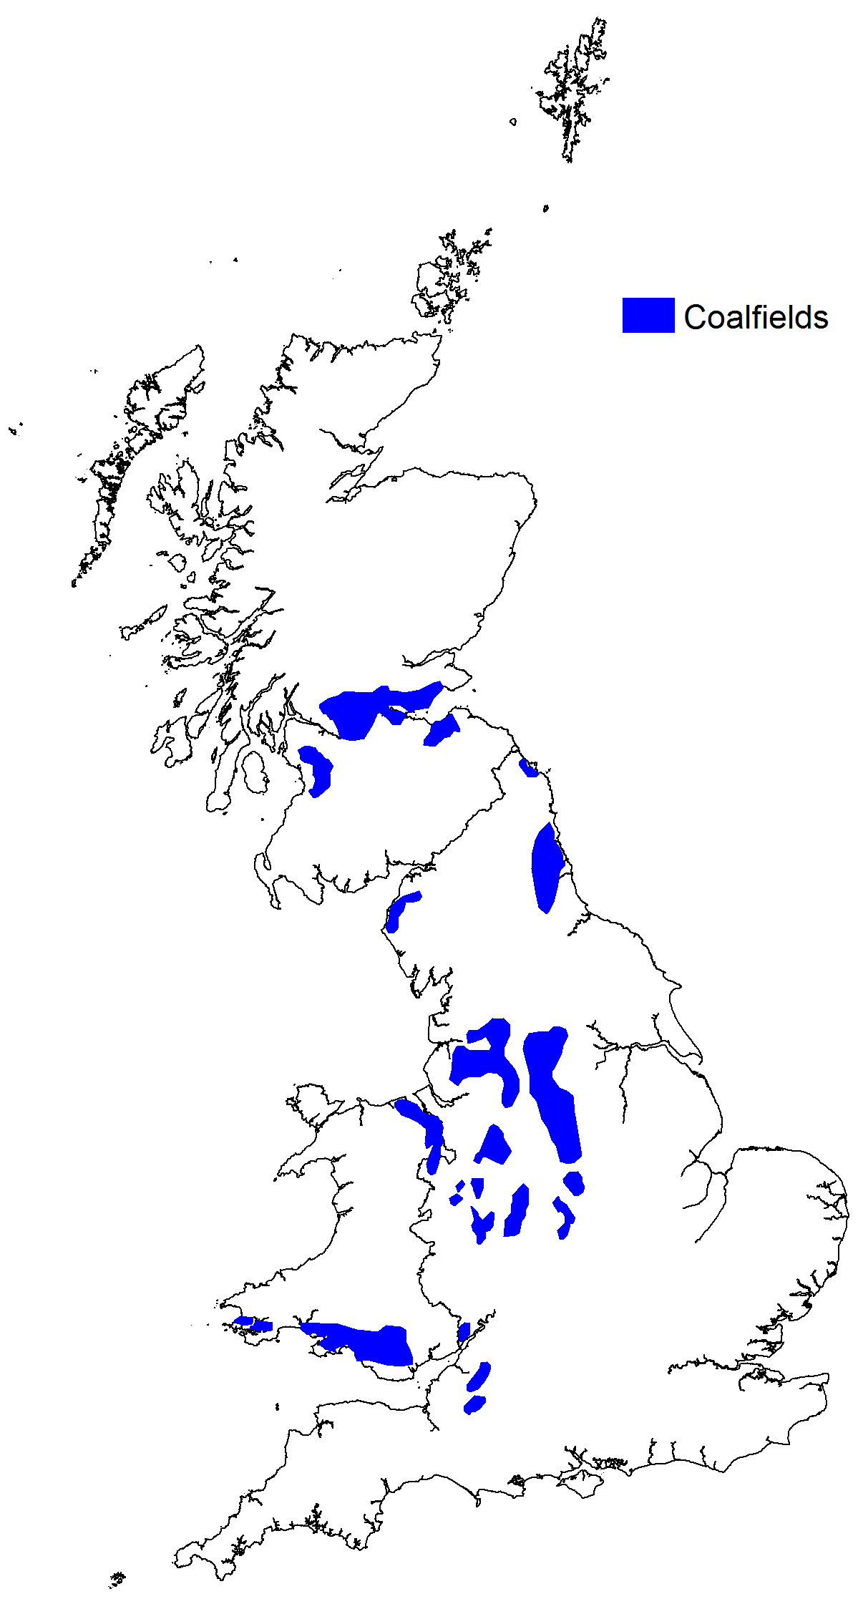
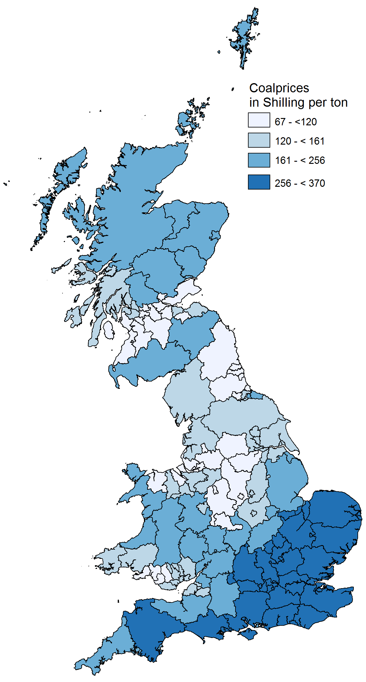
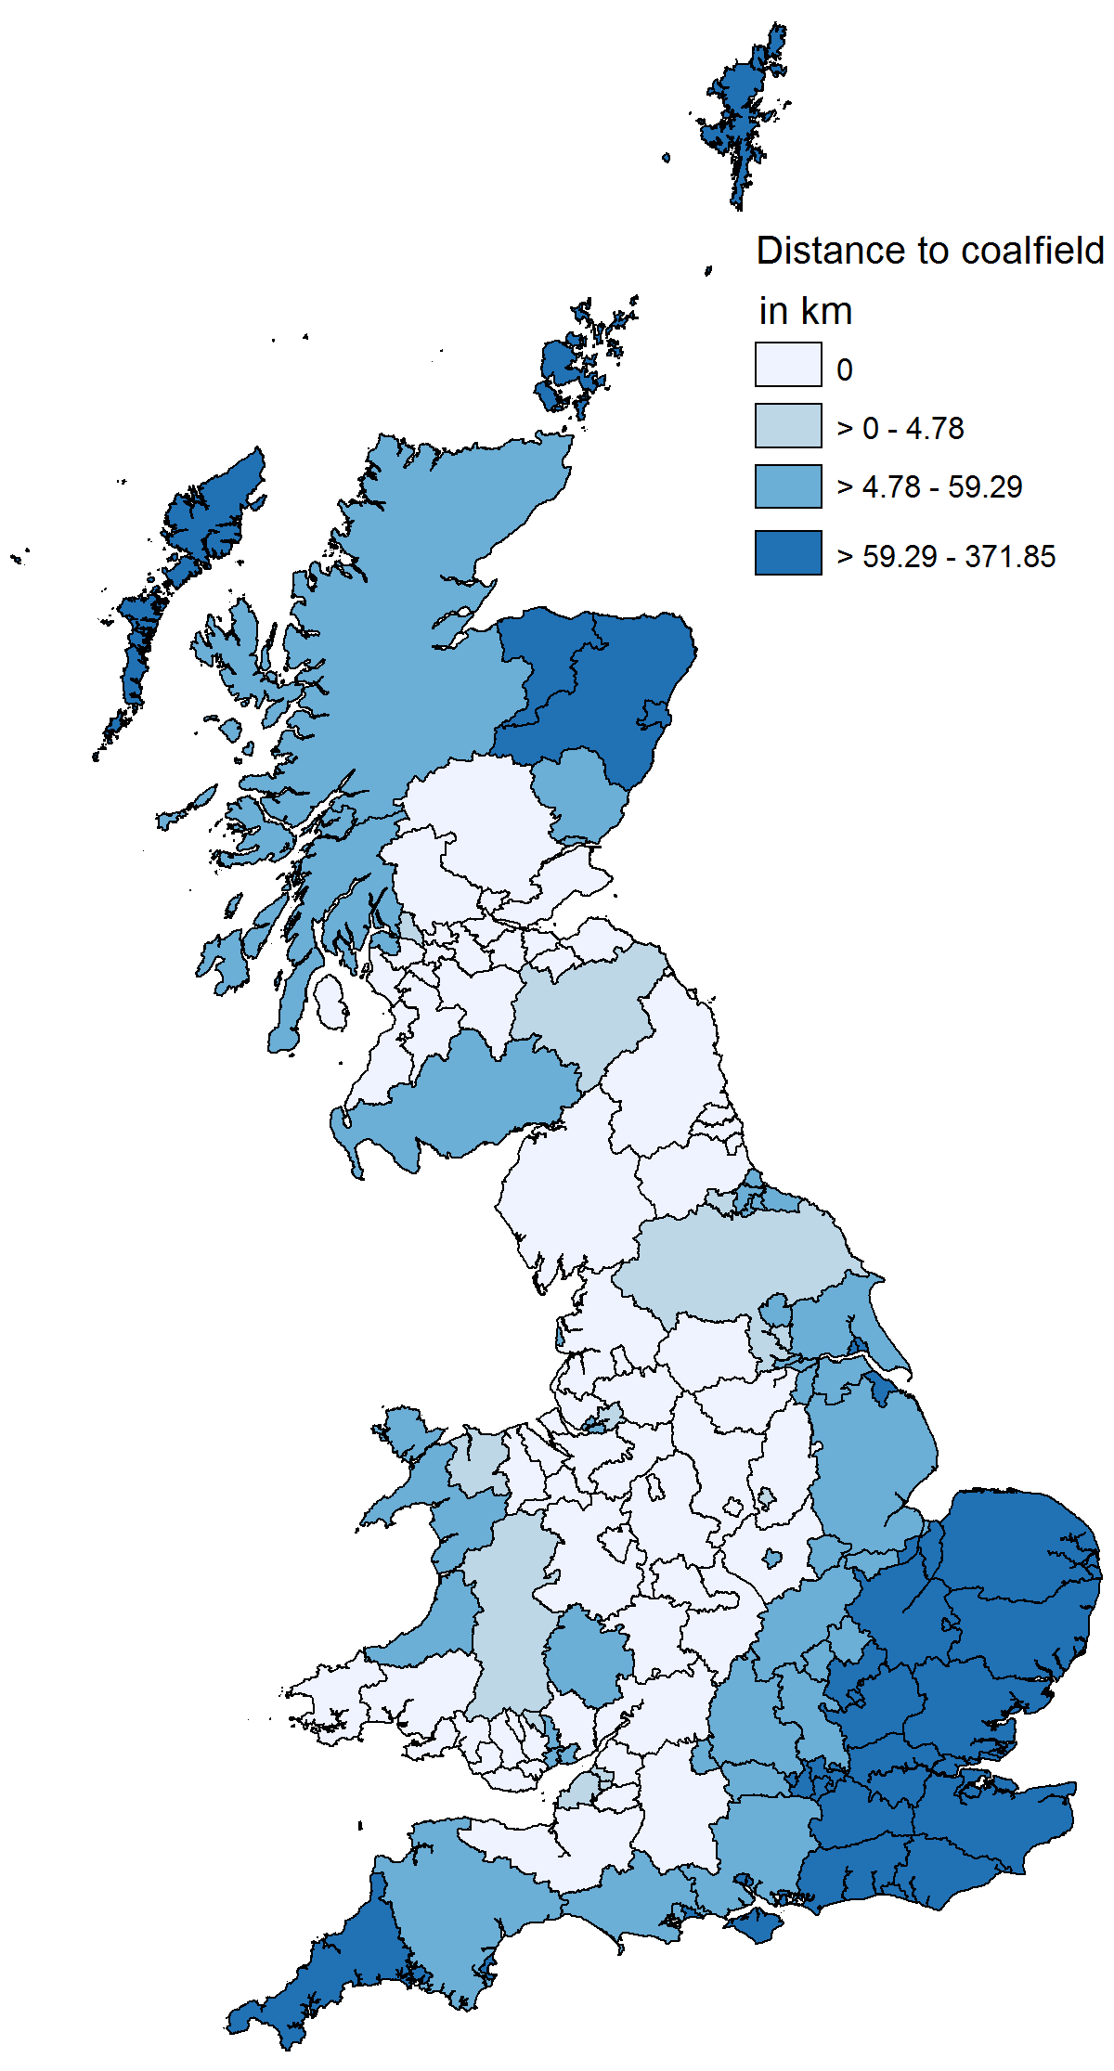
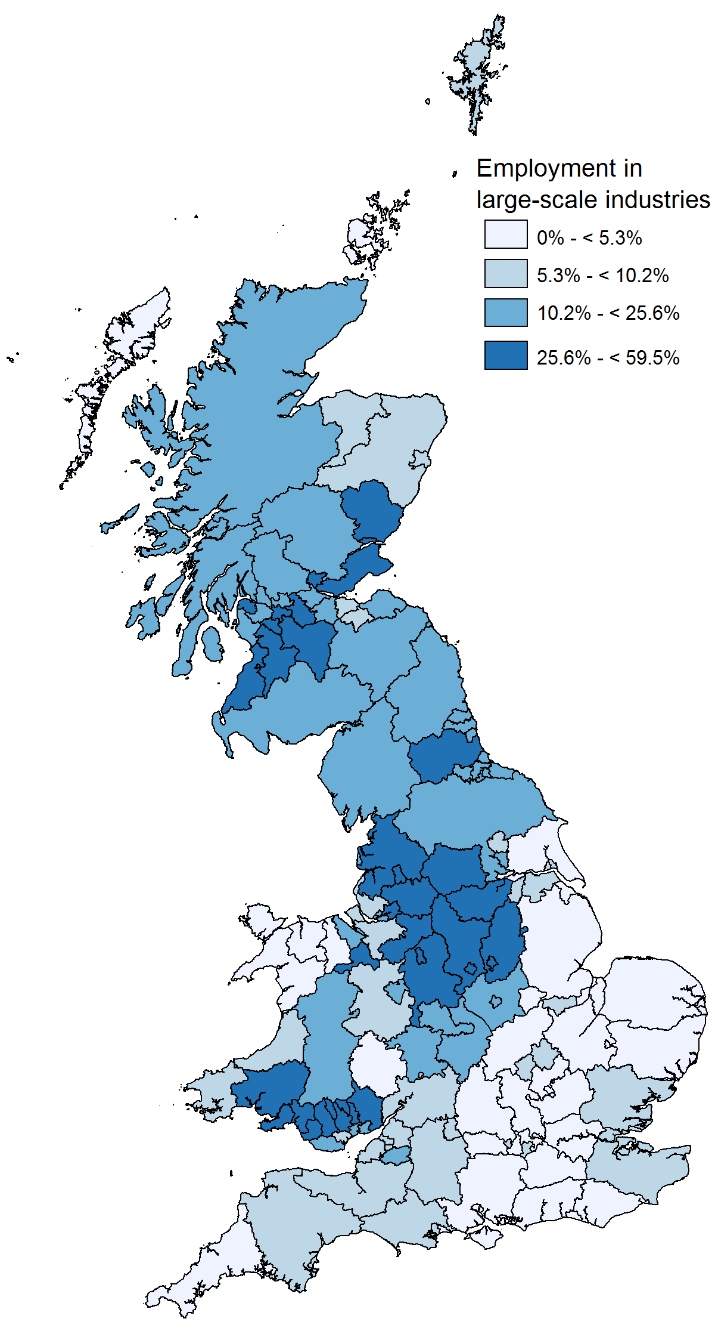
British Coal Fields
1a. Coalfields around 1700 | 1b. Minimum distance to nearest coalfield | 1c. Coal prices around 1840 | 1d. Employment share in large-scale industries in 1891
Fig. 1. Coal and employment in large-scale industries

Slide 11
Industry Structure (1891) & Characteristics (1901)
Industry | Average Employment share in British regions | Steam-use | Average plant-size
Coal mining | 5.1 | n.a. | n.a.
Food, drink & tobacco | 5.8 | 0.94 | 15.0
Chemicals | 0.7 | 2.44 | 35.9
Metal manufacturers | 3.8 | 7.10 | 67.6
Mechanical engineering | 2.4 | 2.5 | 50.3
Instrument engineering | 0.2 | 2.5 | 23.0
Electrical engineering | 0.1 | 2.5 | 64.8
Shipbuilding | 1.0 | 1.96 | 164.4
Vehicles | 0.6 | 1.51 | 62.4
Metal goods | 0.9 | 1.57 | 32.6
Textiles | 6.4 | 5.74 | 155.3
Leather | 0.5 | 0.69 | 28.9
Clothing & Footwear | 8.0 | 0.45 | 72.0
Bricks & pottery | 1.2 | 8.02 | 39.7
Timber & furniture | 1.6 | 2.54 | 22.8
Paper & publishing | 1.4 | 2.99 | 21.9

Slide 12
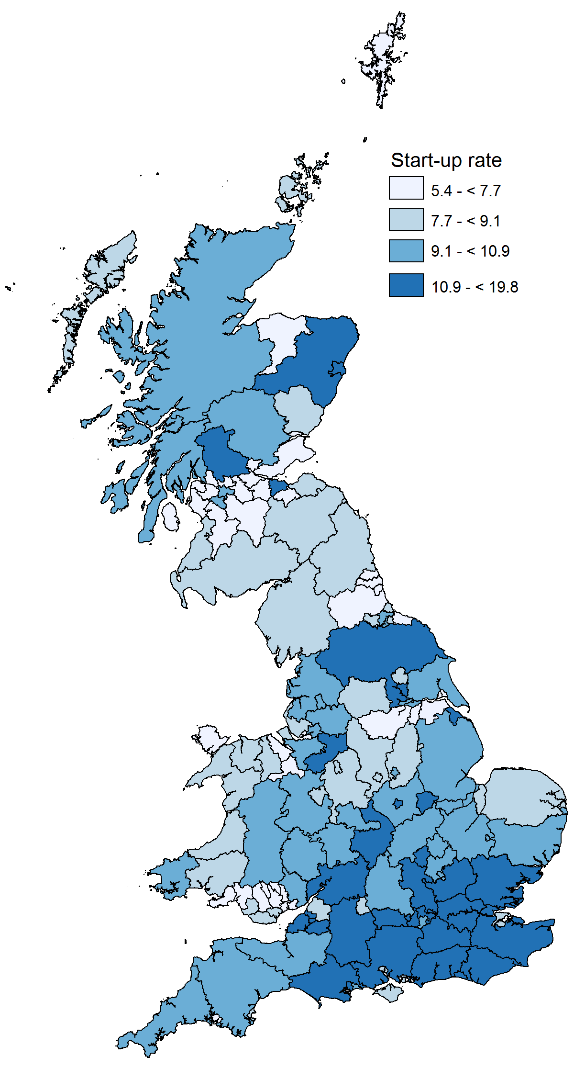
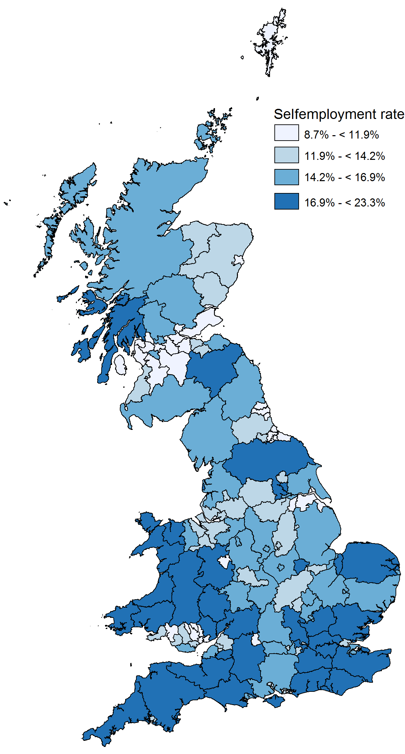
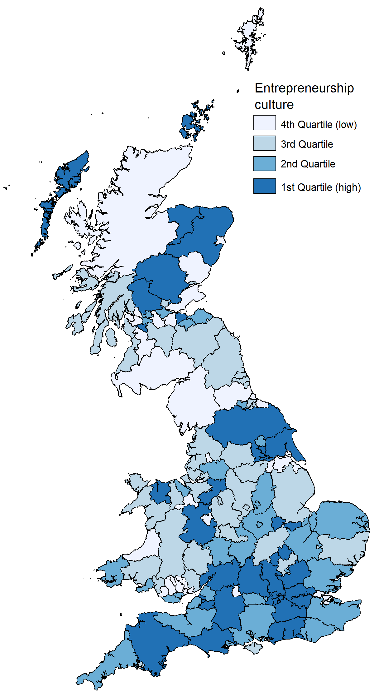
Entrepreneurship Measures, 2011

Slide 13
Instrumental variable regressions
 | first-stage |  | second-stage
 | 1 | 2 | 3 | 4 | 5
 | Employment share, large-scale industries 1891 | Employment share, large-scale industries 1891 | Self-employment rate 2011 | Start-up rate 2011 | Entrepreneurial culture 2009-11
Distance to coalfield | -0.274*** | -0.297*** | --- | --- | ---
Employment share in large-scale industries 1891 | --- | --- | -0.154*** | -0.169*** | -0.188***
Water mills around 1800 | --- | -0.116** | 0.0469*** | -0.000477 | 0.0187
Market potential 1891 | --- | -1.88e-06 | 6.12e-07 | 3.24e-06*** | -5.05e-08
Cities around 1290 | --- | -0.646*** | -0.0285 | -0.0781 | -0.0286
Universities prior 1500 | --- | -0.0305 | -0.209*** | 0.0946 | -0.0215
Harbours around 1290 | --- | 0.164 | -0.0375 | 0.0243 | -0.0518
Limits to agricultural use | --- | -0.0911 | -0.0917 | -0.0993 | 0.0648
Depth to rock | --- | -0.0388 | -0.0193 | 0.0268* | 0.0436
Mean July temperature | --- | -0.0114 | 0.0392*** | 0.0178 | 0.0848*
Ruggedness | --- | -0.000155 | 0.000129* | 6.06e-05 | 0.000156
Employment 1891 | --- | 5.81e-07* | 1.55e-07** | 3.60e-07*** | 2.78e-07**
Population density 1891 | --- | -3.08e-05 | -5.85e-05* | -3.22e-05 | -2.72e-05

Slide 14
Robustness check with contemporary controls
 | first-stage | second-stage
 | 1 | 2 | 3 | 4
 | Employment share in large-scale industries 1891 | Self-employment rate 2011 | Start-up rate 2011 | Entrepreneurial culture 2009-11
Distance to coalfield | -0.287*** | --- | --- | ---
Employment share in large-scale industries 1891 | --- | -0.168*** | -0.170*** | -0.185***
Water mills around1800 | -0.187*** | 0.0488*** | 0.0117 | 0.0473
Market potential 1891 | 2.83e-06 | 1.45e-06* | 2.77e-06*** | -1.12e-06
Cities around 1290 | -0.705*** | -0.0351 | -0.0644 | -0.00163
Universities prior 1500 | 0.0929 | -0.182*** | 0.0840 | -0.0525
Harbours around 1290 | 0.197 | -0.0377 | 0.0186 | -0.0651
Limits to agricultural use | -0.141 | -0.117 | -0.101 | 0.0692
Depth to rock | 0.00842 | -0.0135 | 0.0229 | 0.0325
Mean July temperature | 0.0307 | 0.0437*** | 0.0139 | 0.0734
Ruggedness | -8.46e-05 | 0.000134** | 5.49e-05 | 0.000140
Employment 1891 | 7.79e-07*** | 8.48e-08 | 2.81e-07*** | 1.45e-07
Change unemployment rate 2001-2011 | -0.0105*** | -0.00223*** | 0.000966 | 0.00222
Change GVA per head 2001-2011 | -0.00945** | -0.00263* | 0.00125 | 0.00253
Population density 2011 | -0.000120** | -1.67e-05 | 8.19e-06 | 3.46e-05

Slide 15
Robustness check with entrepreneurial culture based on youth residence
 | first-stage | second-stage
 | 1 | 2
 | Employment share in large-scale industries 1891 | Entrepreneurial culture 2009-2011
Distance to coalfield | -0.297*** | -0.0945**
Employment share in large-scale industries 1891 | --- | ---
Water mills around 1800 | -0.116** | -0.00117
Market potential 1891 | -1.88e-06 | 1.05e-06
Cities around 1290 | -0.646*** | 0.0603
Universities prior 1500 | -0.0305 | -0.00468
Harbours around 1290 | 0.164 | 0.000249
Limits to agricultural use | -0.0911 | 0.0982
Depth to rock | -0.0388 | 0.00873
Mean July temperature | -0.0114 | -0.0122
Ruggedness | -0.000155 | -2.08e-05
Employment 1891 | 5.81e-07* | 2.51e-07***
Population density 1891 | -3.08e-05 | -3.48e-05

Slide 16
Robustness check using 1813-1820 male employment data
 | first stage | second stage
 | 1 | 3 | 4 | 5
 | Employment share in large-scale industries 1813-1820 | Self-employment rate 2011 | Start-up rate 2011 | Entrepreneurial culture 2009-2011
Distance to coalfield | -0.445*** | --- | --- | ---
 | (0.0313)
Employment share in large-scale industries 1813-1820 |  | -0.126*** | -0.124*** | -0.160***
Watermills around 1800 | -0.205*** | 0.0539*** | 0.00113 | 0.0580*
Market potential 1811 | 5.11e-06 | -6.18e-07 | 6.52e-06*** | 4.02e-06*
Cities around 1290 | -0.171 | 0.00794 | -0.0226 | 0.0231
Universities prior 1500 | 0.194 | -0.140** | -0.0899** | -0.0106
Harbours around 1290 | 0.225* | -0.0265 | 0.00201 | -0.0261
Limits to agricultural use | -0.760*** | 0.224*** | 0.216** | 0.284**
Depth to rock | -0.0654 | -0.000166 | 0.0225 | 0.0121
Mean July temperature | -0.205** | 0.0175 | -0.0165 | 0.0176
Ruggedness | -0.000294 | 0.000196** | 3.01e-05 | -9.25e-05
Population 1811 | 1.81e-06** | 2.43e-07*** | 7.00e-07*** | 4.55e-07***
Population density 1811 | 0.000245 | -4.02e-05 | -1.54e-05 | 0.000215

Slide 17
Mediation analysis
 | Indirect effect |  |  | Direct effect
 | Observed coefficient | LLCI | ULCI | Observed coefficient | LLCI | ULCI
Human capital on start-up rate | -.026** (.013) | -.055 | -.007 | -.200*** (.042) | -.026 | -.095
Human capital on self-employment rate | .002 (.018) | -.034 | .038 | -.208*** (.053) | -.308 | -.104
Human capital on entrepreneurship culture | -.006** (.003) | -.014 | -.002 | -.013* (.007) | -.027 | .001

Slide 18
Indirect evidence for industry structure effects
 | first-stage | second-stage
 | 1 | 2
 | DV: Employment share in large-scale industries 1891 | DV: Self-employment rate 1891
Distance to coalfield | -0.297*** | ---
Employment share in large-scale industries 1891 | --- | -0.394***
Water mills around1800 | -0.116** | 0.0544***
Market potential 1891 | -1.88e-06 | -4.51e-06***
Cities around 1290 | -0.646*** | -0.0954*
Universities prior 1500 | -0.0305 | -0.0390
Harbours around 1290 | 0.164 | 0.00842
Limits to agricultural use | -0.0911 | 0.116
Depth to rock | -0.0388 | -0.0103
Mean July temperature | -0.0114 | -0.00529
Ruggedness | -0.000155 | -2.92e-05
Employment 1891 | 5.81e-07* | -1.77e-07
Pop density 1891 | -3.08e-05 | -1.39e-05

Slide 19
Main Findings
Presence of large-scale industries in British regions in the 19th century negatively affects contemporary entrepreneurial activity
Entrepreneurship capital may have long, historical imprint that is difficult to overcome
May be incompatible with EU Smart Specialization Strategy
Entrepreneurship capital may be more exogenous than endogenous

Slide 20
Standortpolitik
Locational policies
Strategic Management of Place

Slide 21
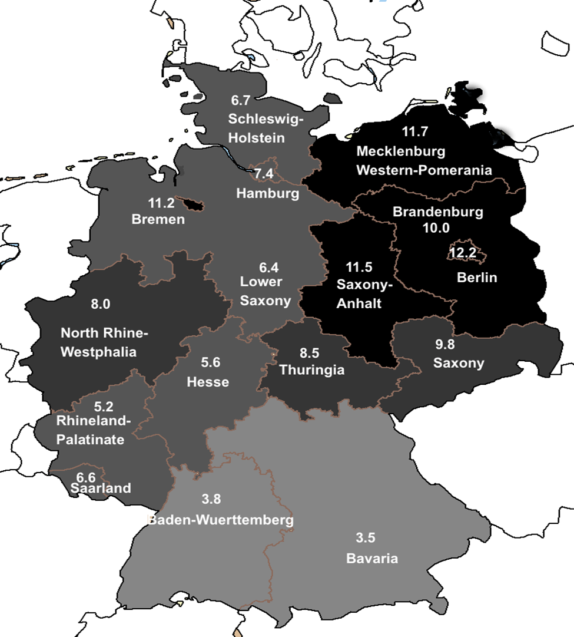
Variations in Economic Performance Across Geographic Space (unemployment rate, 2014)

Slide 22
What is the Strategic Management of Place?
“Combine liberal amounts of technology, entrepreneurs, capital, and sunshine. Add one (1) University. Stir vigorously.”
-- Gordon Moore, Founder, Intel

Slide 23
Factors & Resources
Physical Capital (Robert Solow)
Natural Resources (David Riccardo)
Unskilled Labor
Skilled Labor
Human Capital (Gary Becker)
Creative Class (Richard Florida)
Knowledge (Paul Romer)

Slide 24
Spatial Structure & Organization
Clusters (Michael Porter, The Competitive Advantage of Nations, Harvard University Press, 1994)
Specialization (Ken Arrow)
Diversification (Jane Jacobs)
Market Power (Alfred Chandler)
(Localized) Competition (Ed Glaeser)
Entrepreneurship
Global Linkages

Slide 25
Human Dimension
Networks, linkages & interactions – social capital (AnnaLee Saxenien, Regional Advantage, Harvard University Press, 1994)
Leadership (Al Link, A Generosity of Spirit, Duke University Press, 1995)
Identity & Image (Albert O. Hirschman, Exit, Voice and Loyalty, Harvard University Press, 1970)

Slide 26
Policy
Institutions
Absorptive capacity mechanisms
Capabilities
Global benchmarking
Context Matters

Slide 27
Conclusions
Is Entrepreneurship Exogenous or Endogenous?
Can Policy Make A Difference?
Answer may not be “yes” or “no” but rather depend upon context

